Slide 1

Design and Analysis of Algorithms
Dr. Bhavanishankar K
Asst. Prof. Dept. of CSE
RNSIT, Bengaluru, India

Slide 2
Backtracking – N Queens Problem
The problem is to place n queens on an n × n chessboard so that no two queens attack each other by being in the same row or in the same column or on the same diagonal.
When n= 1?
When n =2 ?
When n= 3?
When n=4?
Q
Q
 | ?
Q
 |  | Q
? | ? | ?
 | Q
? | ? | ?
 |  | Q
Q
? | ? | ?

Slide 3
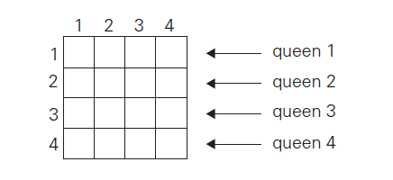
Backtracking – N Queens Problem
When n=4?

Slide 4
Backtracking – N Queens Problem
When n=4?
Q

Slide 5
Backtracking – N Queens Problem
When n=4?
Q
?
?
?

Slide 6
Backtracking – N Queens Problem
When n=4?
Q
Q

Slide 7
Backtracking – N Queens Problem
When n=4?
Q
Q
Dead end !!!!
?
?
?
?

Slide 8
Backtracking – N Queens Problem
When n=4?
Q
Q

Slide 9
Backtracking – N Queens Problem
When n=4?
Q
Q
?
?

Slide 10
Backtracking – N Queens Problem
When n=4?
Q
Q
Q

Slide 11
Backtracking – N Queens Problem
When n=4?
Q
Q
Q
Dead end !!!!
?
?
?
?

Slide 12
Backtracking – N Queens Problem
When n=4?
Q
Q
Q
Q
Solution 1

Slide 13
Backtracking – N Queens Problem
When n=4? Alternate solution ??
Q
Q
Q
Q
Solution 1

Slide 14
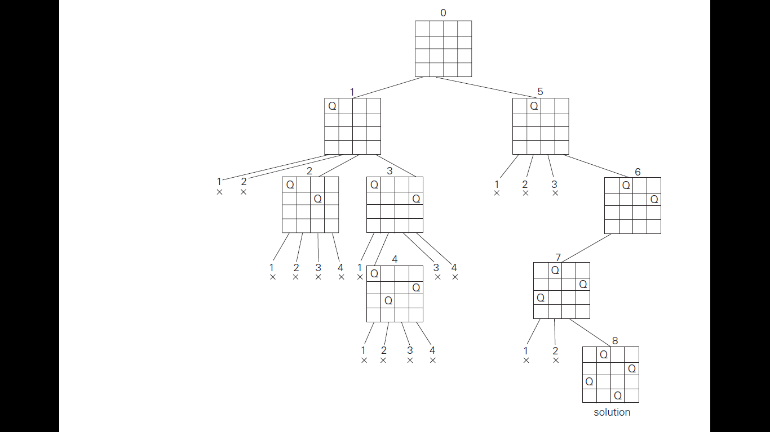
Backtracking – N Queens Problem

Slide 15
Backtracking – N Queens Problem

Slide 16
Design and Analysis of Algorithms
Dr. Bhavanishankar K
Asst. Prof. Dept. of CSE
RNSIT, Bengaluru, India

Slide 17
Backtracking – Sum of subsets
Given set A = {a₁, . . . , a_{n}} of n positive integers, find subset/s whose sum is equal to a given positive integer d.
Example:
A = {1, 2, 5, 6, 8} and d = 9,
there are two solutions:
{1, 2, 6}
{1, 8}.
B={11, 13, 24, 7} and d= 31
There are two solutions
{11,13,7}
{24, 7}

Slide 18
Backtracking – Sum of subsets
Solution approach
Sort the set’s elements in increasing order.
a₁< a₂ < . . . < a_{n}
The state space tree can be constructed as binary tree
The root of the tree represents the starting point, with no decisions about the given elements made as yet
Its left and right children represent, respectively, inclusion and exclusion of a1 in a set
Similarly, going to the left from a node of the first level corresponds to inclusion of a2 while going to the right corresponds to its exclusion, and so on

Slide 19
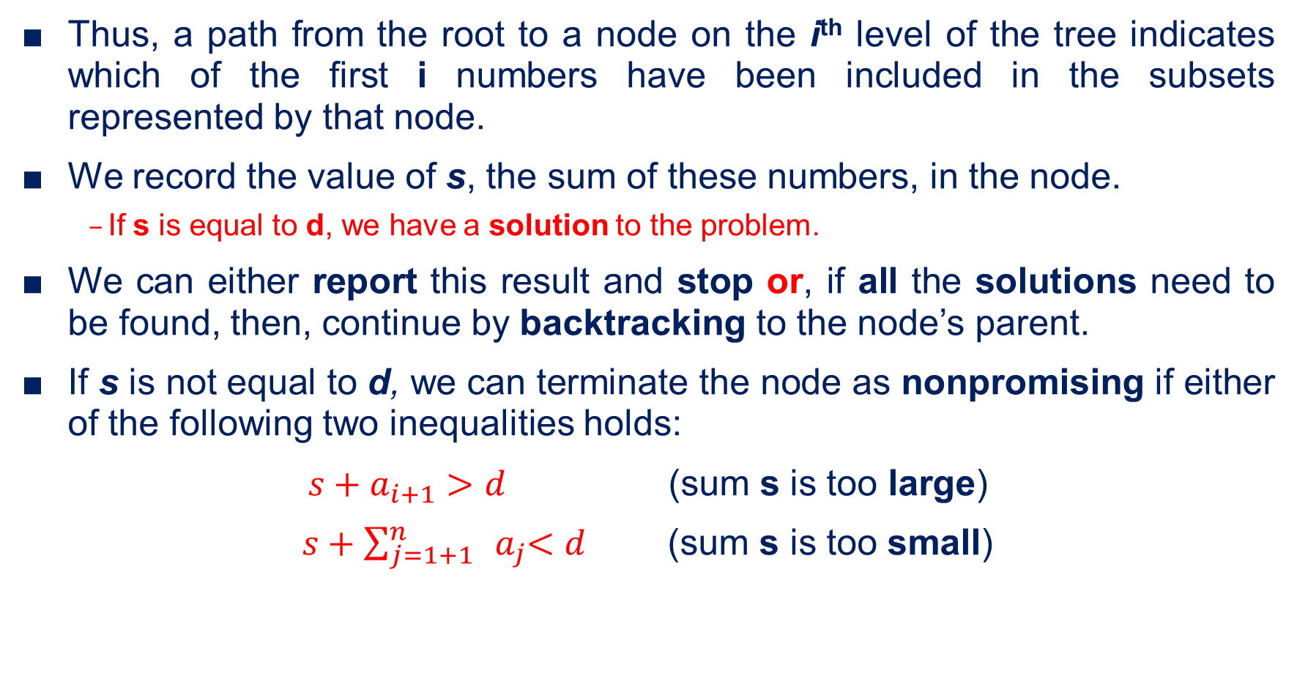
Backtracking – Sum of subsets
Thus, a path from the root to a node on the i^{th} level of the tree indicates which of the first i numbers have been included in the subsets represented by that node.
We record the value of s, the sum of these numbers, in the node.
If s is equal to d, we have a solution to the problem.
We can either report this result and stop or, if all the solutions need to be found, then, continue by backtracking to the node’s parent.
If s is not equal to d, we can terminate the node as nonpromising if either of the following two inequalities holds:
$s+a_{i+1}>d$ (sum s is too large)
$s+\sum_{j=1+1}^{n}{{ a}_{j}<d}$ (sum s is too small)

Slide 20
Backtracking – Sum of subsets
Apply backtracking to solve the following instance of the subset sum problem: A = {3, 5, 6, 7} and d = 15.
Draw the complete state space tree
Solution
Arrange the elements in ascending order
Compute the sum Ts of all the elements
If Ts is less than d
then no solution
Start drawing the state space tree

Slide 21
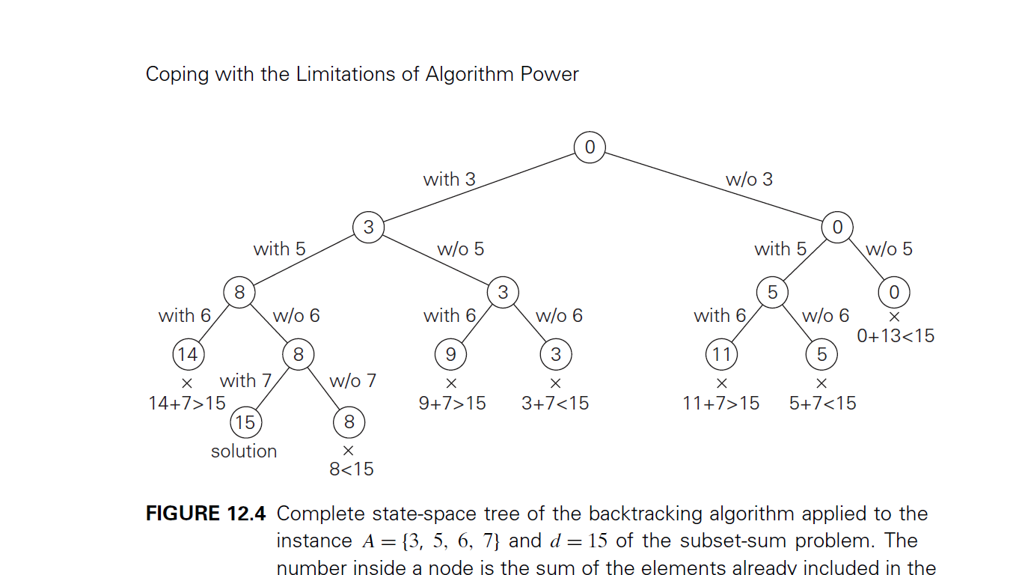
Backtracking – Sum of subsets

Slide 22
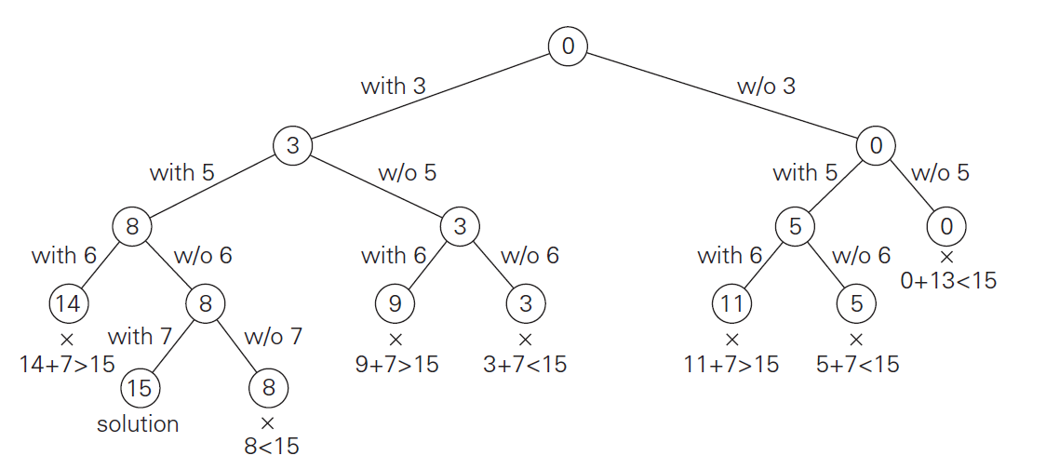
Backtracking – Sum of subsets

Slide 23
Backtracking – Sum of subsets
Apply backtracking to solve the following instance of the subset sum problem: A = {1, 3, 4, 5} and d = 11.
Draw the complete state space tree

Slide 24
Design and Analysis of Algorithms
Dr. Bhavanishankar K
Asst. Prof. Dept. of CSE
RNSIT, Bengaluru, India

Slide 25
Backtracking – Graph Coloring
Consider this fictional continent

Slide 26
Backtracking – Graph Coloring
Lets remove all borders but you may still want to see all the countries.
1 color is sufficient? No !!!! Its insufficient.

Slide 27
Backtracking – Graph Coloring
So add another color.
Now try to fill in every country with one of the two colors.

Slide 28
Backtracking – Graph Coloring
So add another color.
Now try to fill in every country with one of the two colors.

Slide 29
Backtracking – Graph Coloring
So add another color.
Now try to fill in every country with one of the two colors.

Slide 30
Backtracking – Graph Coloring
So add another color.
Now try to fill in every country with one of the two colors.

Slide 31
Backtracking – Graph Coloring
PROBLEM !!!!!
Two adjacent countries forced to have same color. Border unseen.

Slide 32
Backtracking – Graph Coloring
So add another color

Slide 33
Backtracking – Graph Coloring
Insufficient.
Need 4 colors because of this country.

Slide 34
Backtracking – Graph Coloring
Using 4 colors, the entire graph is colored and the borders are clearly seen

Slide 35
Backtracking – Graph Coloring
For each region introduce a vertex
For each pair of regions with a positive-length common border introduce an edge:
Region to be coloured
Coloring regions is equivalent to coloring vertices of dual graph.

Slide 36
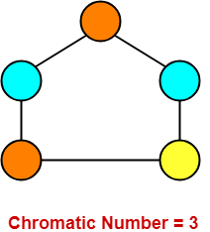
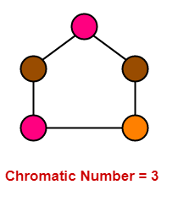
Backtracking – Graph Coloring
Given an undirected graph and m colours, the task is to find whether is it possible to colour the vertices of the graph using m colours with a constraint that no two adjacent vertices can have same colour.
Minimum number of colours required to colour the graph with the said constraint is called chromatic number

Slide 37
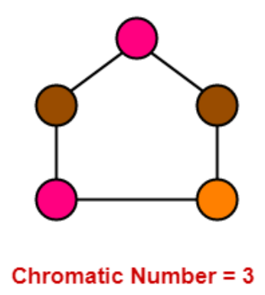
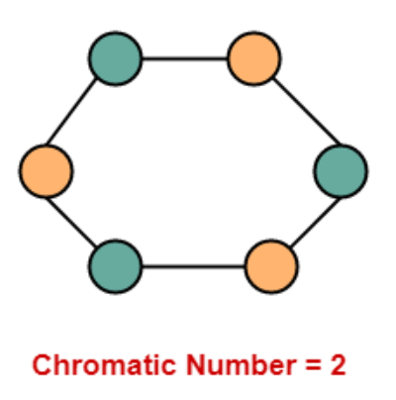
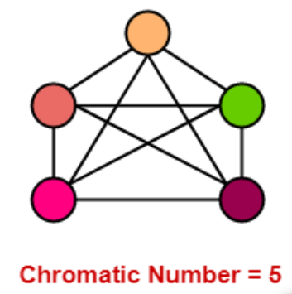
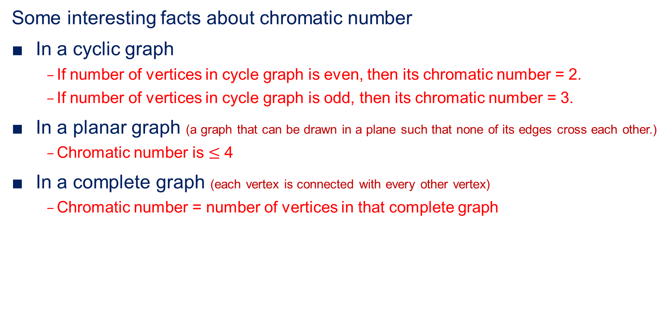
Backtracking – Graph Coloring
Some interesting facts about chromatic number
In a cyclic graph
If number of vertices in cycle graph is even, then its chromatic number = 2.
If number of vertices in cycle graph is odd, then its chromatic number = 3.
In a planar graph (a graph that can be drawn in a plane such that none of its edges cross each other.)
Chromatic number is $≤$ 4
In a complete graph (each vertex is connected with every other vertex)
Chromatic number = number of vertices in that complete graph

Slide 38
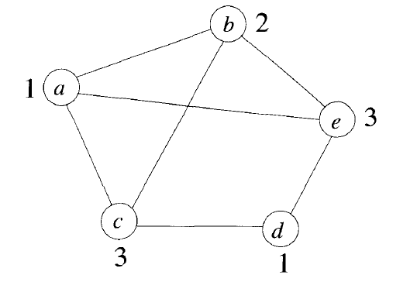
Backtracking – Graph Coloring
Problem statement
Let G be a graph and m be a given positive integer.
Discover whether the nodes of G can be colored in such a way that no two adjacent nodes have the same color yet only m colors are used.
This is termed the m-colorability decision problem
The m-colorability optimization problem asks for the smallest integer m for which the graph G can be colored
This integer m is referred to as the chromatic number of the graph
Chromatic no. =3

Slide 39
Backtracking – Graph Coloring
4 colour problem for planar graphs
A graph is said to be planar iff it can be drawn in a plane in such away that no two edges cross each other
A famous special case of the m colourability decision problem is the 4-color problem for planar graphs
This problem asks the following question:
given any map, can the regions be colored in such a way that no two adjacent regions have the same color yet only four colors are needed
This turns out to be a problem for which graphs are very useful, because a map can easily be transformed into a graph.
Each region of the map becomes a node, and if two regions are adjacent, then the corresponding nodes are joined by an edge

Slide 40
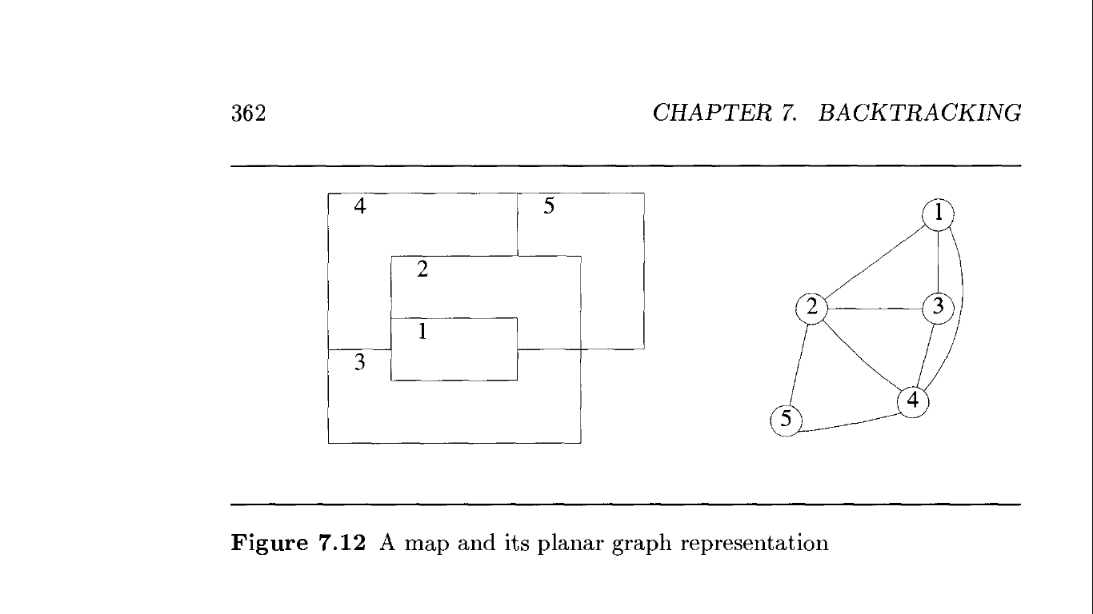
Backtracking – Graph Coloring
Map and its corresponding graph representation

Slide 41
Backtracking – Graph Coloring
Solve the following instance of graph colouring. Draw the state space tree

Slide 42
Backtracking – Graph Coloring
Nodes
Tree
1
R
1
2
R
?
2
3
X
G
?
5
4
3
R
?
G
B
X
1
X
2
3
4
R
G
Y
B
X
X
X
4
5
5
R
G
B
Y
X
X

Slide 43
Design and Analysis of Algorithms
Dr. Bhavanishankar K
Asst. Prof. Dept. of CSE
RNSIT, Bengaluru, India

Slide 44
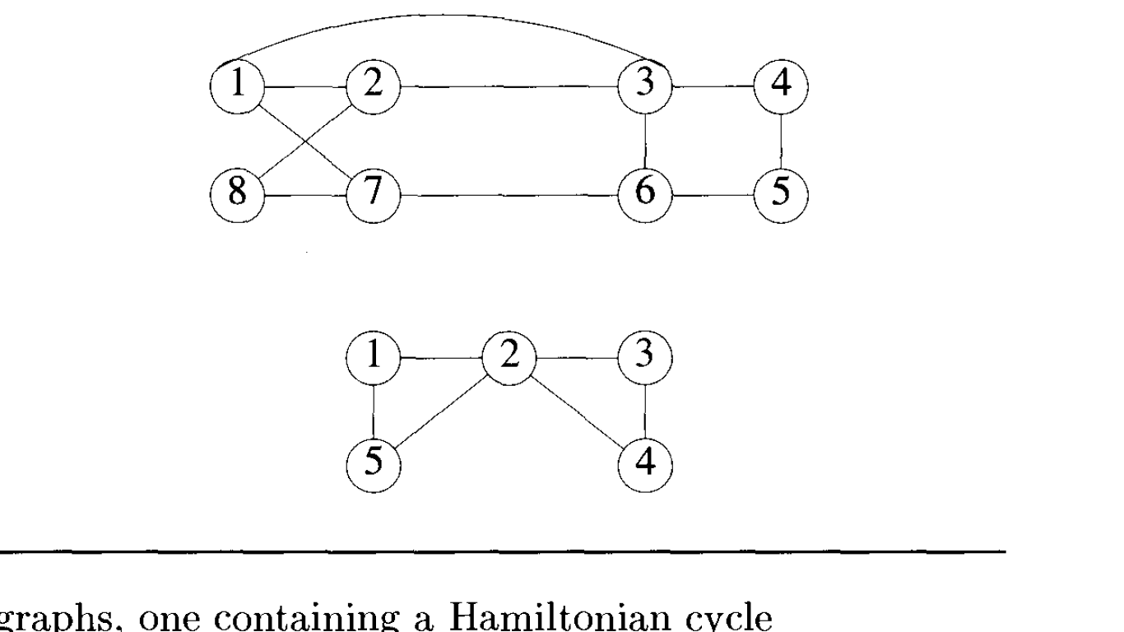
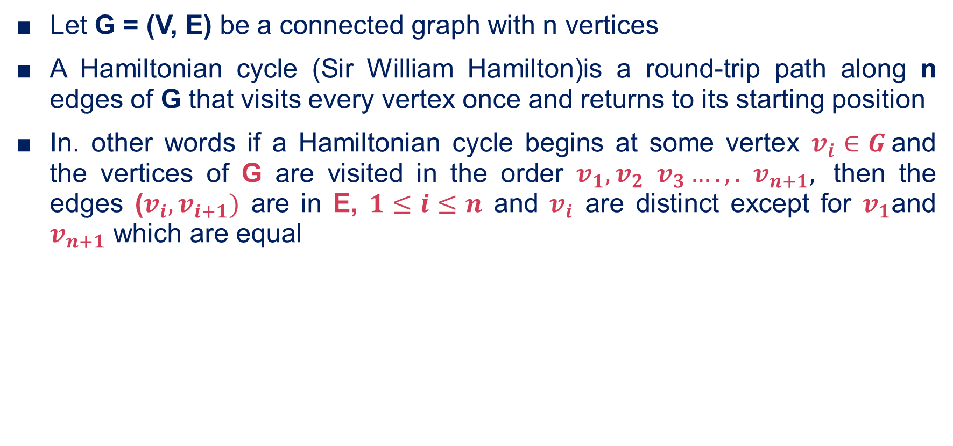
Backtracking – Hamiltonian Cycle
Let G = (V, E) be a connected graph with n vertices
A Hamiltonian cycle (Sir William Hamilton)is a round-trip path along n edges of G that visits every vertex once and returns to its starting position
In. other words if a Hamiltonian cycle begins at some vertex $v_{i}∈G$and the vertices of G are visited in the order $v_{1},v_{2}$ $v_{3}….,.$ $v_{n+1},$ then the edges ($v_{i},v_{i+1})$ are in E, $1≤i≤n$ and $v_{i}$ are distinct except for $v_{1}$and $v_{n+1}$ which are equal
1, 2, 8, 7, 6, 5, 4, 3, 1
No Hamiltonian cycle !!!!

Slide 45
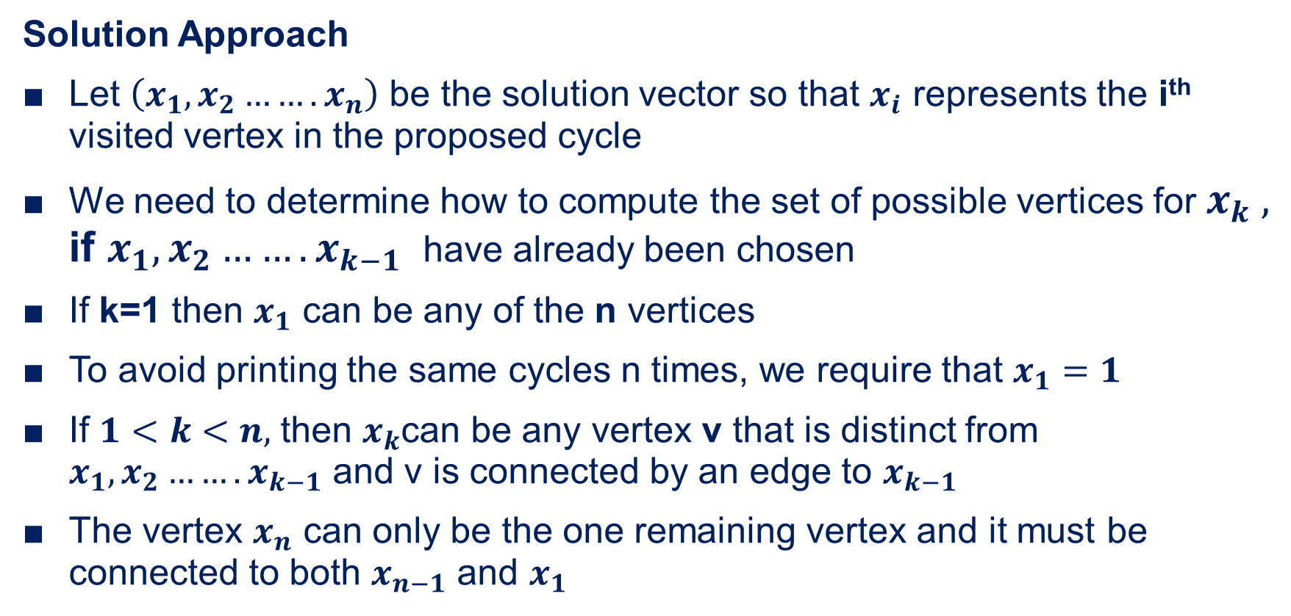
Backtracking – Hamiltonian Cycle
Solution Approach
Let $\left(x_{1},x_{2}…….x_{n}\right)$ be the solution vector so that $x_{i}$ represents the i^{th} visited vertex in the proposed cycle
We need to determine how to compute the set of possible vertices for $x_{k} ,$ if $x_{1},x_{2}…….x_{k−1}$ have already been chosen
If k=1 then $x_{1}$ can be any of the n vertices
To avoid printing the same cycles n times, we require that $x_{1}=1$
If $1<k<n,$ then $x_{k}$can be any vertex v that is distinct from $x_{1},x_{2}…….x_{k−1}$ and v is connected by an edge to $x_{k−1}$
The vertex $x_{n}$ can only be the one remaining vertex and it must be connected to both $x_{n−1}$ and $x_{1}$

Slide 46
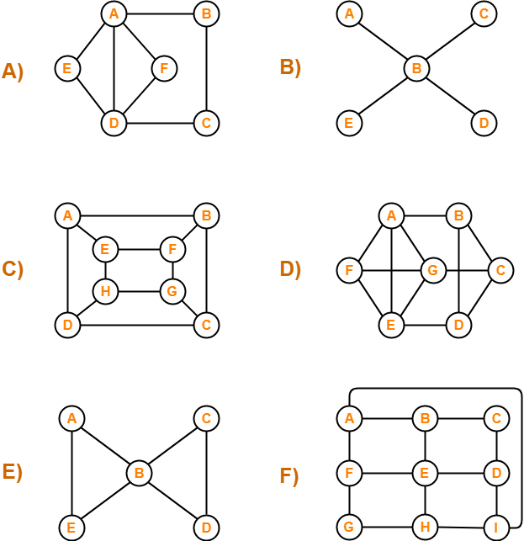
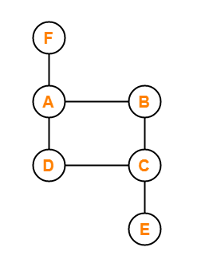
Backtracking – Hamiltonian Cycle
Which of the following are Hamiltonian graphs ?

Slide 47
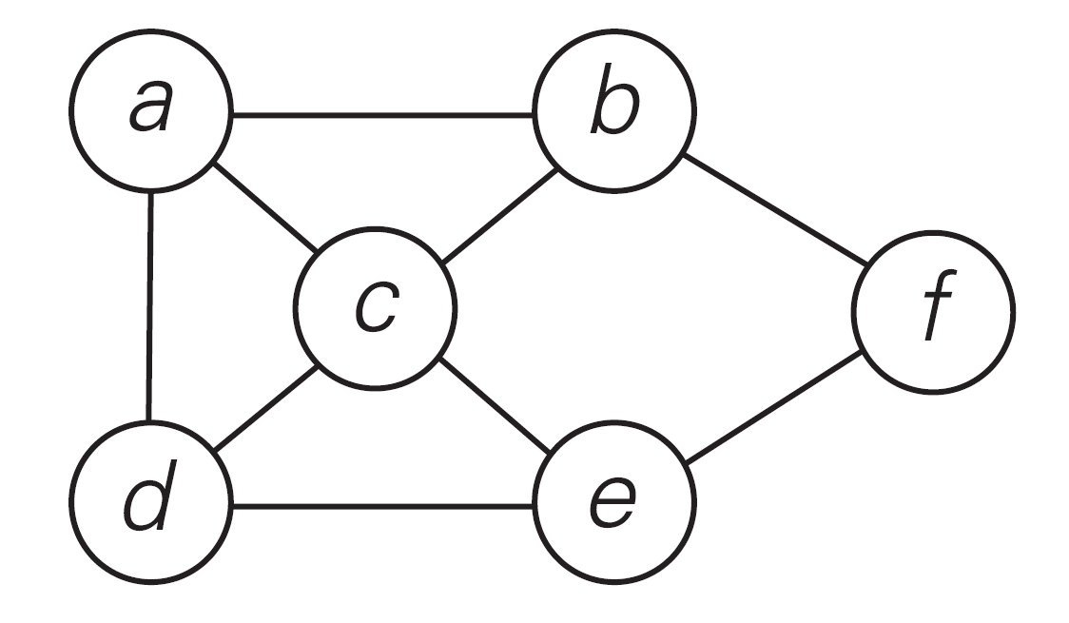
Backtracking – Hamiltonian Cycle
State Space Tree Construction
Solve the following instance of Hamiltonian cycle and draw the state space tree

Slide 48
Backtracking – Hamiltonian Cycle
a
b
c
f
d
e
e
< a, b, f, e, c, d, a >
e
d
f
c
Dead end !!!!!!
Dead end !!!!!!
f
d
Dead end !!!!!!
a

Slide 49

backtracking

Slide 50
Branch and Bound
The idea of backtracking is to cut off a branch of the problem’s state-space tree as soon as we can deduce that it cannot lead to a solution
To handle optimization problems, the same concept can be strengthened
An optimization problem seeks to minimize or maximize some objective function (a tour length, the value of items selected, the cost of an assignment etc.) subjected to constraints
Recall
Feasible solution
Optimal Solution

Slide 51
Branch and Bound
Compared to backtracking, branch-and-bound requires two additional items:
a way to provide, for every node of a state-space tree, a bound on the best value of the objective function on any solution that can be obtained by adding further components to the partially constructed solution represented by the node
the value of the best solution seen so far
If this information is available, we can compare a node’s bound value with the value of the best solution seen so far.
If the bound value is not better than the value of the best solution seen so far
i.e., not smaller for a minimization problem and not larger for a maximization problem
the node is nonpromising and can be terminated (some people say the branch is “pruned”).

Slide 52
Branch and Bound
A search path is terminated at the current node in a state-space tree of a branch-and-bound algorithm for any one of the following three reasons:
The value of the node’s bound is not better than the value of the best solution seen so far.
The node represents no feasible solutions because the constraints of the problem are already violated.
The subset of feasible solutions represented by the node consists of a single point (and hence no further choices can be made)—
in this case, we compare the value of the objective function for this feasible solution with that of the best solution seen so far and update the latter with the former if the new solution is better.

Slide 53
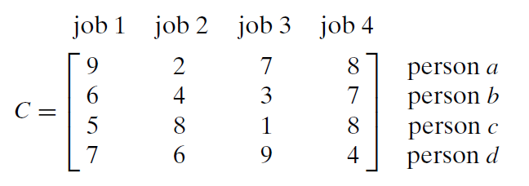
Branch and Bound – Assignment Problem
Problem Statement
Assign n people to n jobs so that the total cost of the assignment is as small as possible
Assignment problem is specified by an n × n cost matrix C
Select one element in each row of the matrix so that no two selected elements are in the same column and their sum is the smallest possible

Slide 54
Branch and Bound – Assignment Problem
How to find a lower bound on the cost of an optimal selection without actually solving the problem
It is clear that the cost of any solution, including an optimal one, cannot be smaller than the sum of the smallest elements in each of the matrix’s rows
For the instance here, this sum is 2 + 3+ 1+ 4 = 10
It is important to stress that this is not the cost of any legitimate selection (3 and 1 came from the same column of the matrix);
it is just a lower bound on the cost of any legitimate selection

Slide 55
Branch and Bound – Assignment Problem
Solve the following instance of assignment problem an obtain the state space tree
First compute the lower bound by finding the sum of the smallest elements in each row
LB= 2+3+1+4=10

Slide 56
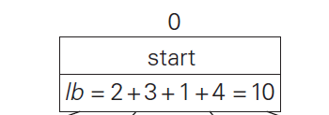
Branch and Bound – Assignment Problem
Consider a job for person a
a->1 lb=9+3+1+4=17
a->2 lb=2+3+1+4=10
a->3 lb=7+4+5+4=20
a->4 lb=8+3+1+6=18
Since a->2, lb=10 is more promising node, we branch from there !!!!

Slide 57

Branch and Bound – Assignment Problem

Slide 58
Branch and Bound – Assignment Problem
Consider a job for person b
b->1 lb=2+ (6+1+4)=13
b->3 lb=2+ (3+5+4)=14
b->4 lb=2+(7+1+7)=17
Since b->1, lb=13 is more promising node, we branch from there !!!!

Slide 59
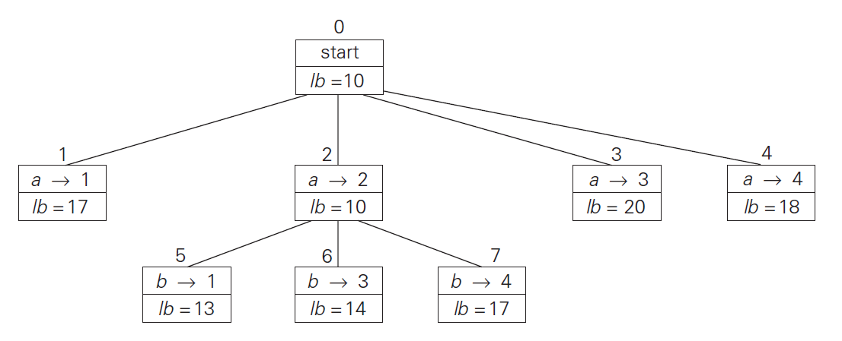
Branch and Bound – Assignment Problem

Slide 60
Branch and Bound – Assignment Problem
Consider job for persons c and d
c->3, d->4 lb=2+6+(1+4)=13
c->4, d->3 lb=2+6+(8+9)=25
c->3, d->4 is more promising
The final assignment of jobs is as follows
a->2 b->1 c->3 d->4

Slide 61
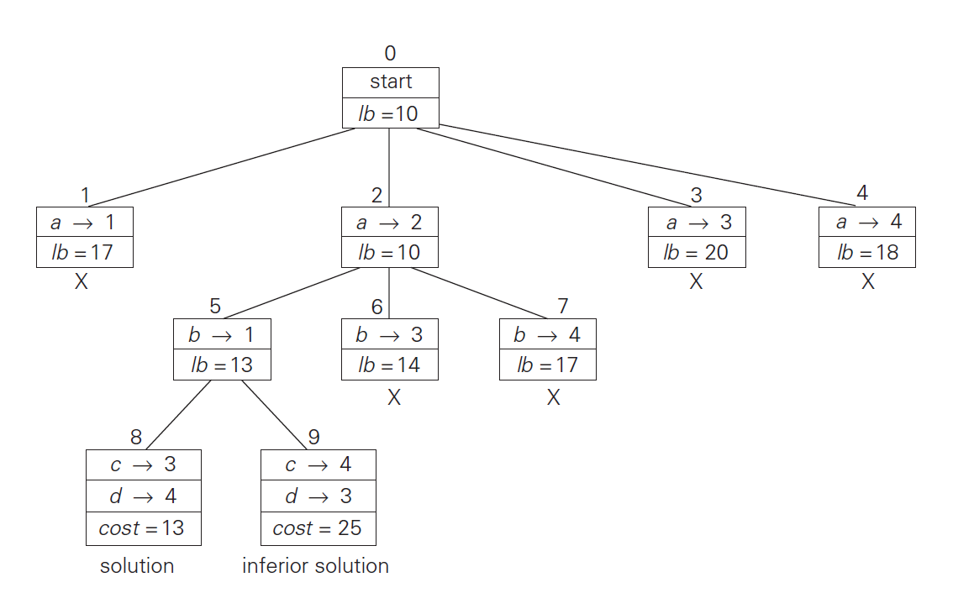
Branch and Bound – Assignment Problem

Slide 62
Design and Analysis of Algorithms
Dr. Bhavanishankar K
Asst. Prof. Dept. of CSE
RNSIT, Bengaluru, India

Slide 63
Branch and Bound – Knapsack Problem
Problem statement
Given n items of known weights w_{i} and values v_{i} , i = 1, 2, . . . , n, and a knapsack of capacity W, find the most valuable subset of the items that fit in the knapsack.
Solution approach
It is convenient to order the items of a given instance in descending order by their value-to-weight ratios
Then the first item gives the best payoff per weight unit and the last one gives the worst payoff per weight unit, with ties resolved arbitrarily:
v₁/w₁ ≥ v₂/w₂ ≥ . . . ≥ v_{n}/w_{n}.

Slide 64
Branch and Bound – Knapsack Problem
Construction of State Space Tree
Each node on the i^{th} level of this tree, 0 ≤ i ≤ n, represents all the subsets of n items that include a particular selection made from the first i ordered items.
This particular selection is uniquely determined by the path from the root to the node:
a branch going to the left indicates the inclusion of the next item, and
a branch going to the right indicates its exclusion
Record the total weight w and the total value v of this selection in the node, along with some upper bound ub on the value of any subset that can be obtained by adding zero or more items to this selection.

Slide 65
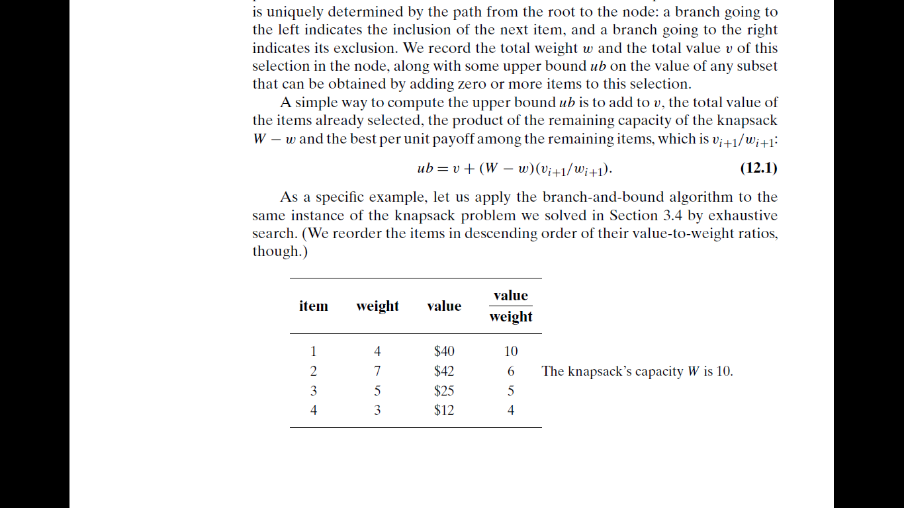

Branch and Bound – Knapsack Problem
Computation of upper bound
A simple way to compute the upper bound ub is to add to v, the total value of the items already selected, the product of the remaining capacity of the knapsack W − w and the best per unit payoff among the remaining items.
$ub=v+\left(W−w\right)({v_{i+1}}/{w_{i+1}}$)

Slide 66
Branch and Bound – Knapsack Problem
Solve the following instance of knapsack problem using branch and bound method

Slide 67
Branch and Bound – Knapsack Problem
Solution
Click for the solution

Slide 68
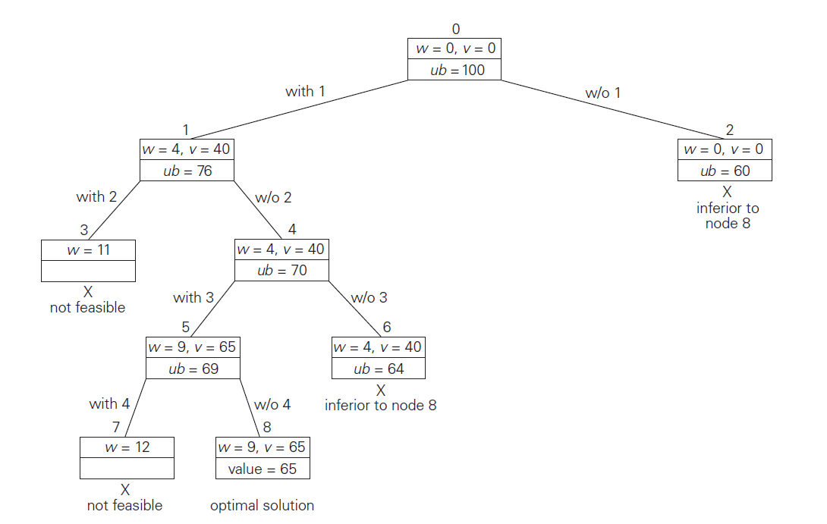
Branch and Bound – Knapsack Problem
State space tree

Slide 69
Branch and Bound – TSP
The problem asks to find the shortest tour through a given set of n cities that visits each city exactly once before returning to the city where it started
The tour is a sequence of vertices v_{i0}, v_{i1}, . . . , v_{in−1}, v_{i0}, where the first vertex of the sequence is the same as the last one and all the other n − 1 vertices are distinct.
Al the tours starts and ends at one particular vertex (Hamiltonian circuit)
Thus, we can get all the tours by generating all the permutations of n − 1 intermediate cities, compute the tour lengths, and find the shortest among them.

Slide 70
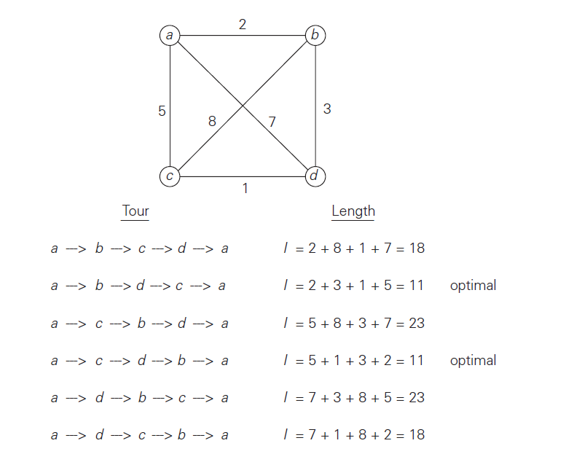
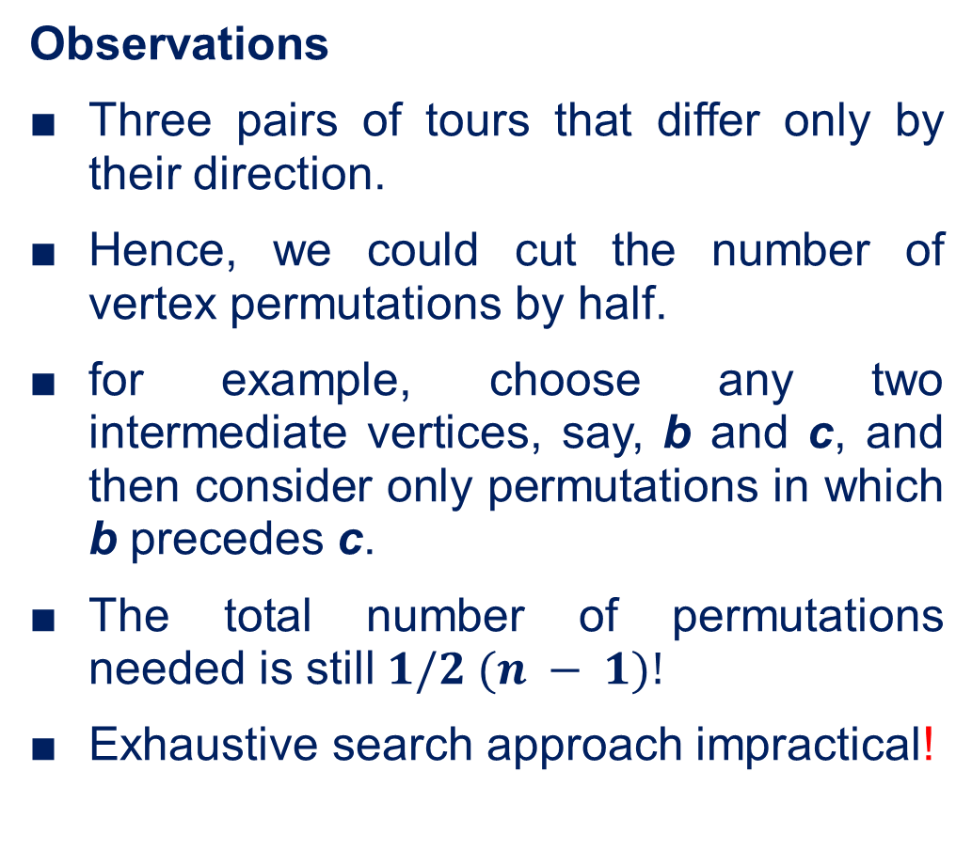
Branch and Bound – TSP
Observations
Three pairs of tours that differ only by their direction.
Hence, we could cut the number of vertex permutations by half.
for example, choose any two intermediate vertices, say, b and c, and then consider only permutations in which b precedes c.
The total number of permutations needed is still $1/2 (n − 1)!$
Exhaustive search approach impractical!

Slide 71
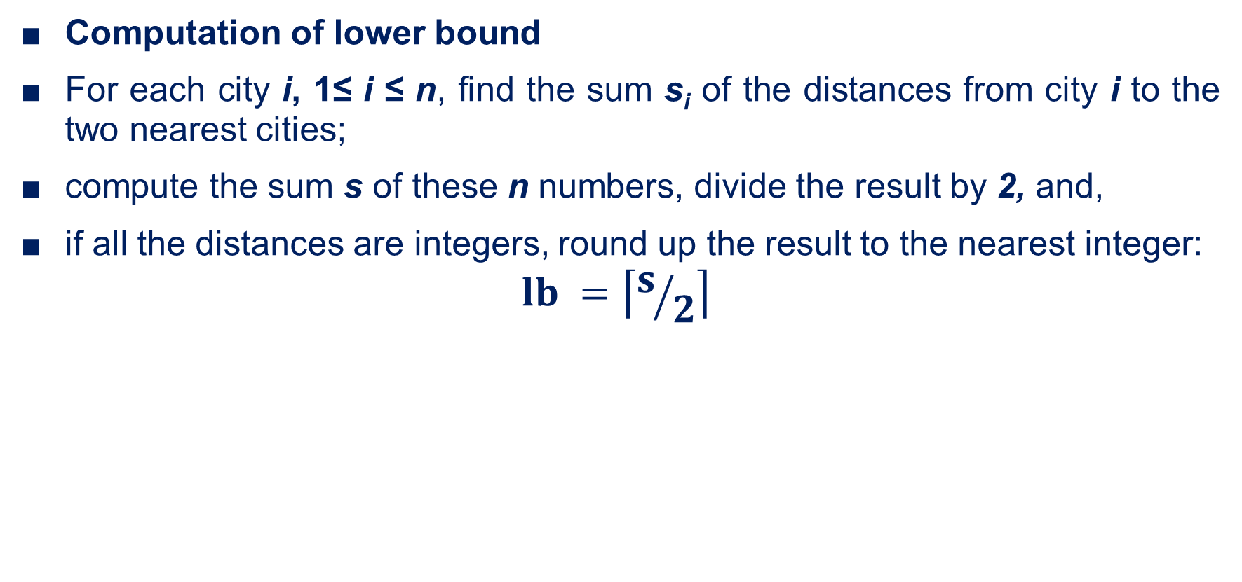
Branch and Bound – TSP
Computation of lower bound
For each city i, 1≤ i ≤ n, find the sum s_{i} of the distances from city i to the two nearest cities;
compute the sum s of these n numbers, divide the result by 2, and,
if all the distances are integers, round up the result to the nearest integer:
$$lb =\left\lceil s/2\right\rceil$$

Slide 72
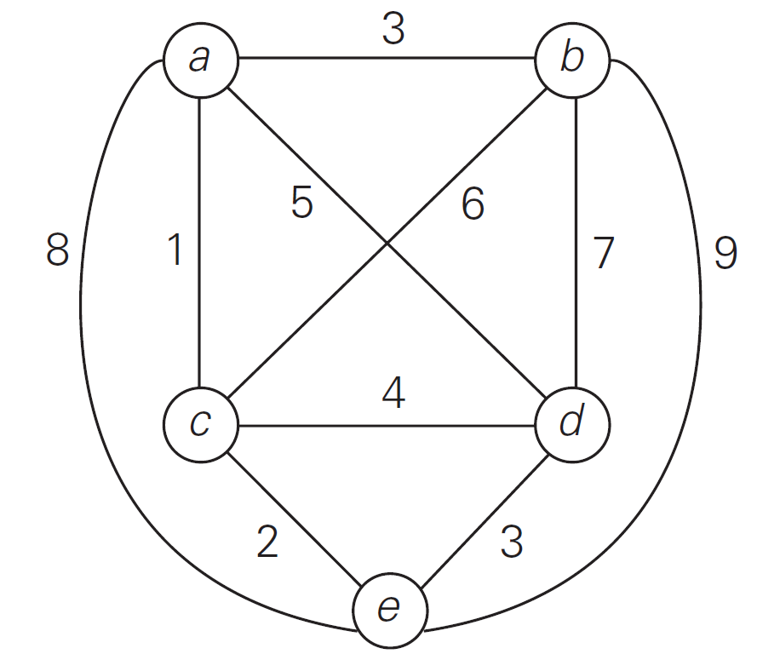
Branch and Bound – TSP
Solve the following instance of TSP using branch and bound method
Solution

Slide 73
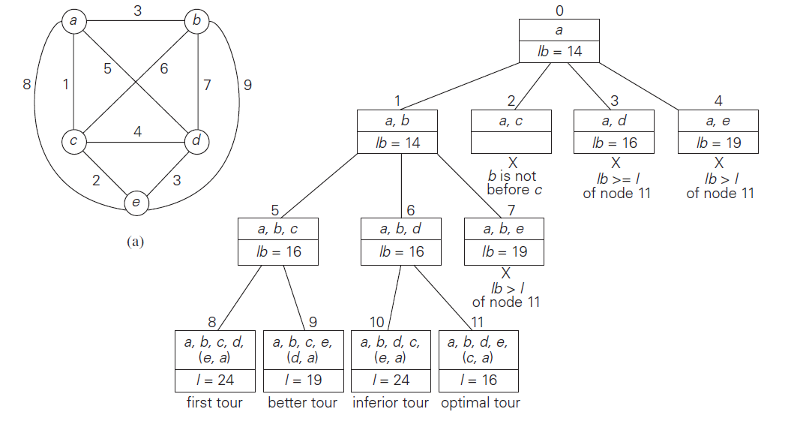
Branch and Bound – TSP

Slide 74
Thank you

